Slide 1




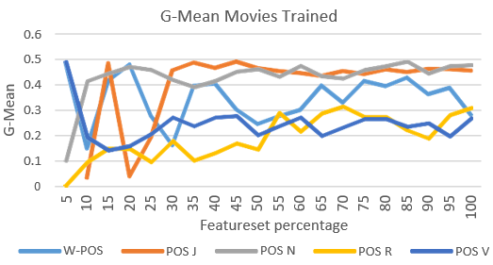
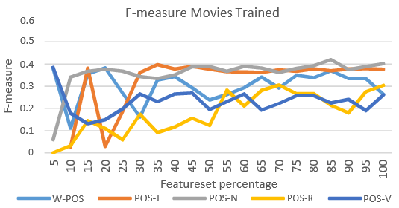
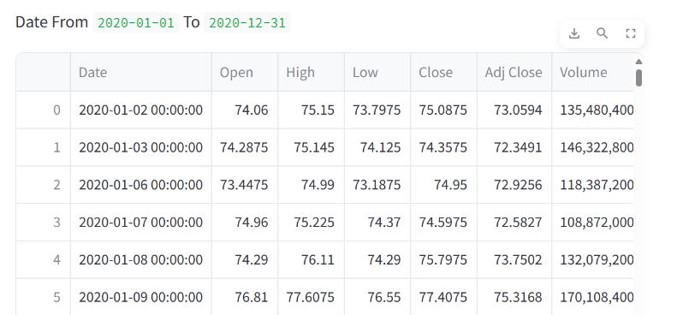
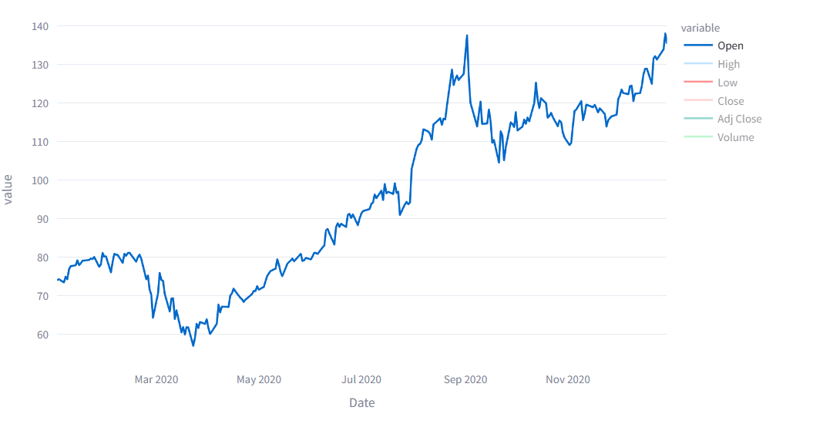
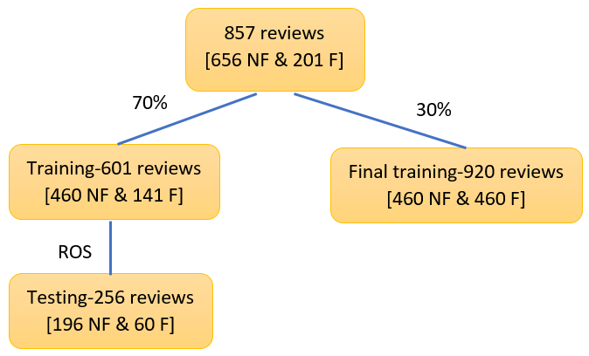
Stock Market Trend
School of Computer Science Engineering and Technology
Bennett University, India
Introduction
Techniques Utilized
Predicting stock market trends is essential for successful investing. Understanding the different methods and challenges involved can help investors make informed decisions.
Problem Statement
The Stack Market Prediction AI project targets precise stock price forecasting amid dynamic financial markets. Challenges include data complexity, varied prediction horizons, and addressing market volatility. An interdisciplinary approach integrating machine learning, finance, and data engineering is crucial for developing reliable forecasting solutions.
Couple of lines on what each technique will do.
User Interface/Demo Snapshots
Solution
Continuous Learning
Adapt to new trends and refine
prediction strategies.
Risk Management
Assess and manage risk in uncertain
market conditions.
Data Driven Decisions
Make informed choices based on
robust trend analysis.
Fig. 2. Data of the stocks
TABLE 1. SAMPLE TABLE
1. Bayesian | 2. Support Vector | 4. Regression
Naïve Bayes | Linear SVC | Logistic Reg.
Multinomial NB | 3. Ensemble | SGD
Bernoulli NB | Random Forest trees | 5. Trees
 | Extra Tree | Decision Trees
Fig. 3. GAPH FOR OPEN VALUE OF THE GIVEN DATA
Achievement: High accuracy ML stock prediction model mitigates market risks, advancing AI investment decisions.
Conclusion
The project's success underscores the pivotal role of AI in enhancing stock market forecasting accuracy, offering invaluable insights for informed investment strategies.
This achievement heralds a new era in leveraging technology to mitigate financial risks and optimize decision-making in dynamic market environments.
Team member—>
*Kashish Rajput* , *Gaurav Raj*
Fig. 1. Sample figure
GitHub or Demo link & Video Link

